Slide 1
Introduction to Data Analysis

Slide 2
DATA VISUALIZATION BASICS
Patrick Boily Data Action Lab | uOttawa | Idlewyld Analytics
pboily@uottawa.ca
[with files from Stephen Davies | DAVHILL]

Slide 3
“Discovery is no longer limited by the collection and processing of data, but rather management, analysis, and visualization.”
@DamianMingle

Slide 4

THE (MESSY) ANALYSIS PROCESS
Objective/
Rationale
Utilization and Decision Support
Data Collection
Data Exploration
Infrastructure and Data Management
Data Preparation
Modeling and Analysis
Communication

Slide 5
PRE-ANALYSIS DATA VISUALIZATION
DATA VISUALIZATION BASICS

Slide 6
PRE-ANALYSIS USE
Data visualization can be used to set the stage for analysis:
detecting anomalous entries invalid entries, missing values, outliers
shaping the data transformations binning, standardization, Box-Cox transformations, PCA-like transformations
getting a sense for the data data analysis as an art form, exploratory analysis
identifying hidden data structure clustering, associations, patterns informing the next stage of analysis

Slide 7
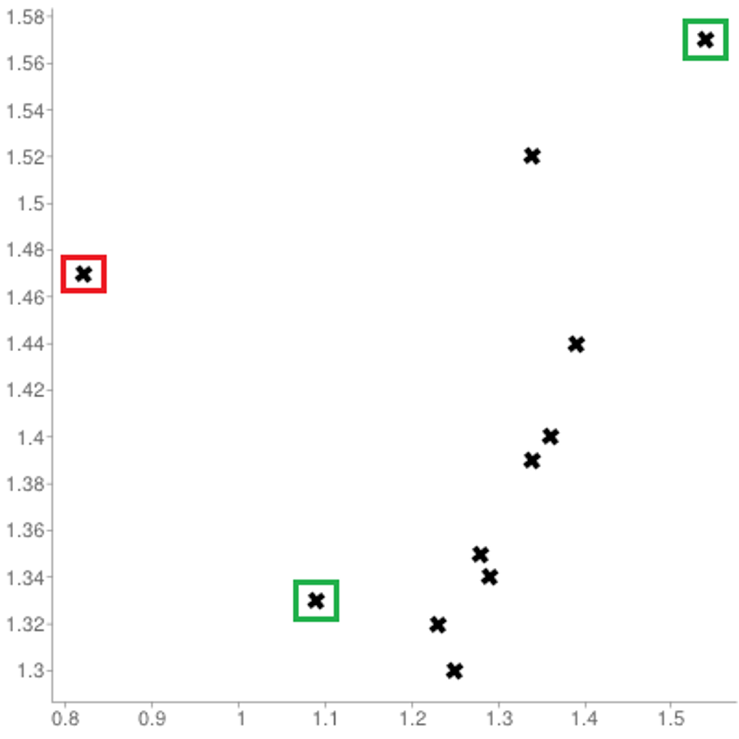
[Personal dataset]
Customers served at counter (per minute)
Customer arrivals at counter (per minute)

Slide 8
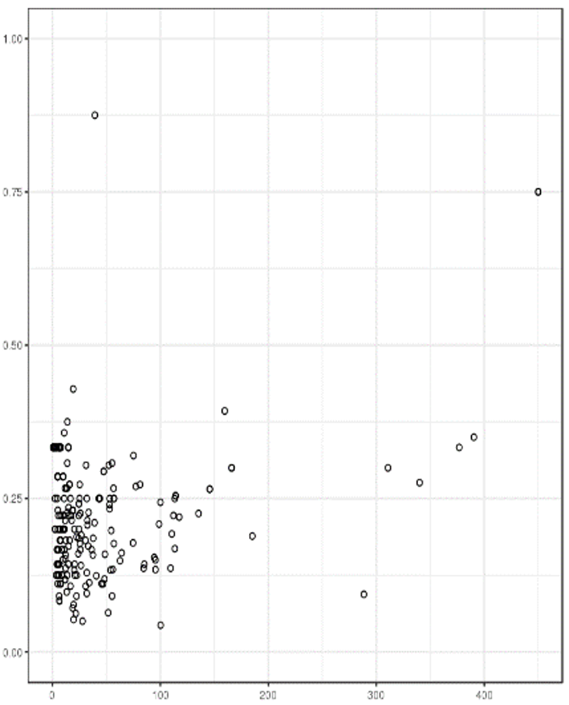
REPRESENTING OBSERVATIONS
[http://promise.site.uottawa.ca/SERepository/datasets/cm1.arff]
2 variables can be represented by position in the plane.
Additional factors can be depicted through:
size
color
value
texture
line orientation
shape
(motion?)
NASA CM1 Dataset (subset)

Slide 9
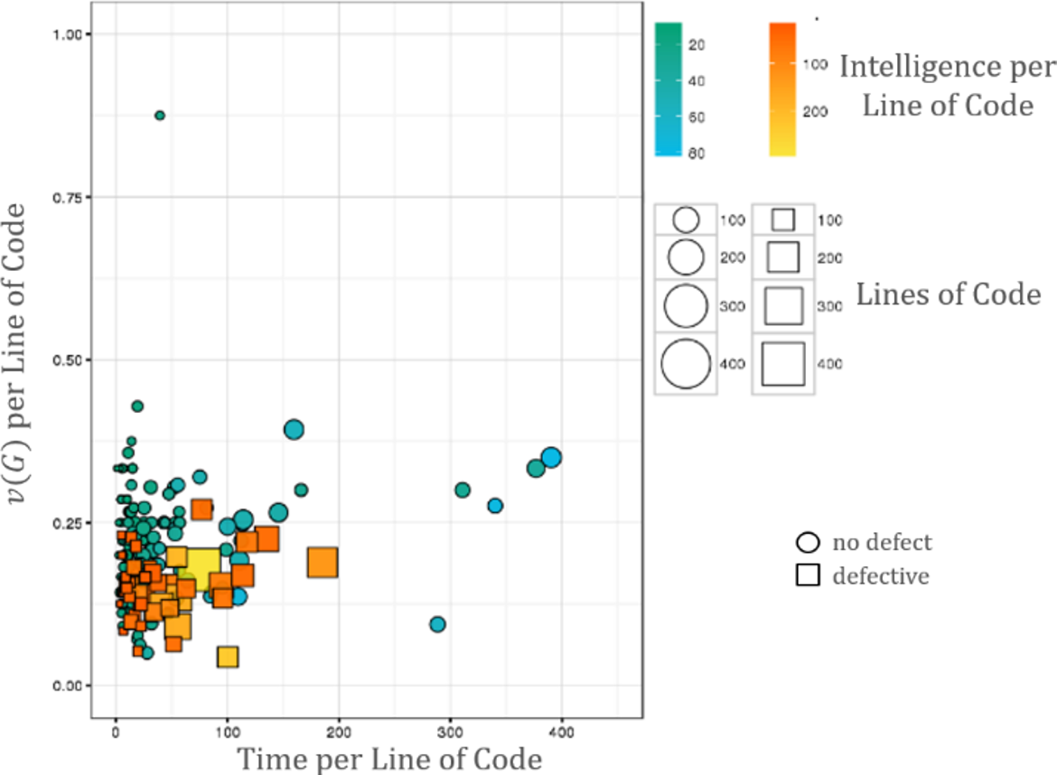
[http://promise.site.uottawa.ca/SERepository/datasets/cm1.arff]
NASA CM1 Dataset (subset)
colour
size
shape
position

Slide 10
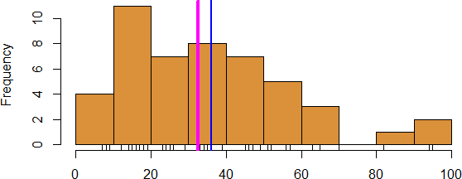
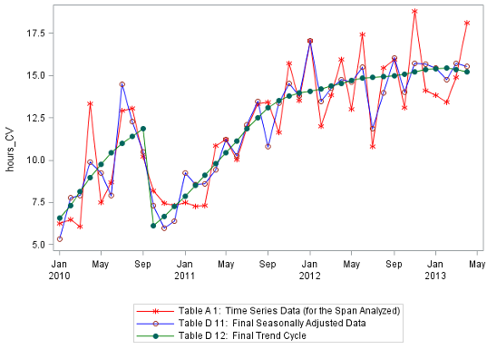
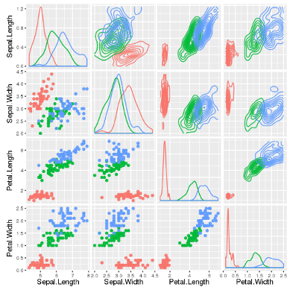
WORKHORSE VISUALIZATIONS
Line Chart/Rug Chart/Number Line
Histogram
Line Graph
Boxplot
Bar Chart
Scatterplot

Slide 11
POST-ANALYSIS DATA VISUALIZATION
DATA VISUALIZATION BASICS

Slide 12
FUNDAMENTAL PRINCIPLES OF ANALYTICAL DESIGN
[E. Tufte, Beautiful Evidence]
Reasoning and communicating our thoughts are intertwined with our lives in a causal and dynamic multivariate Universe.
Symmetry to visual displays of evidence: consumers should be seeking exactly what producers should be providing, namely
meaningful comparisons
causal networks and underlying structure
multivariate links
integrated and relevant data
honest documentation
primary focus on content
Is the point getting across? Is the message being conveyed?

Slide 13
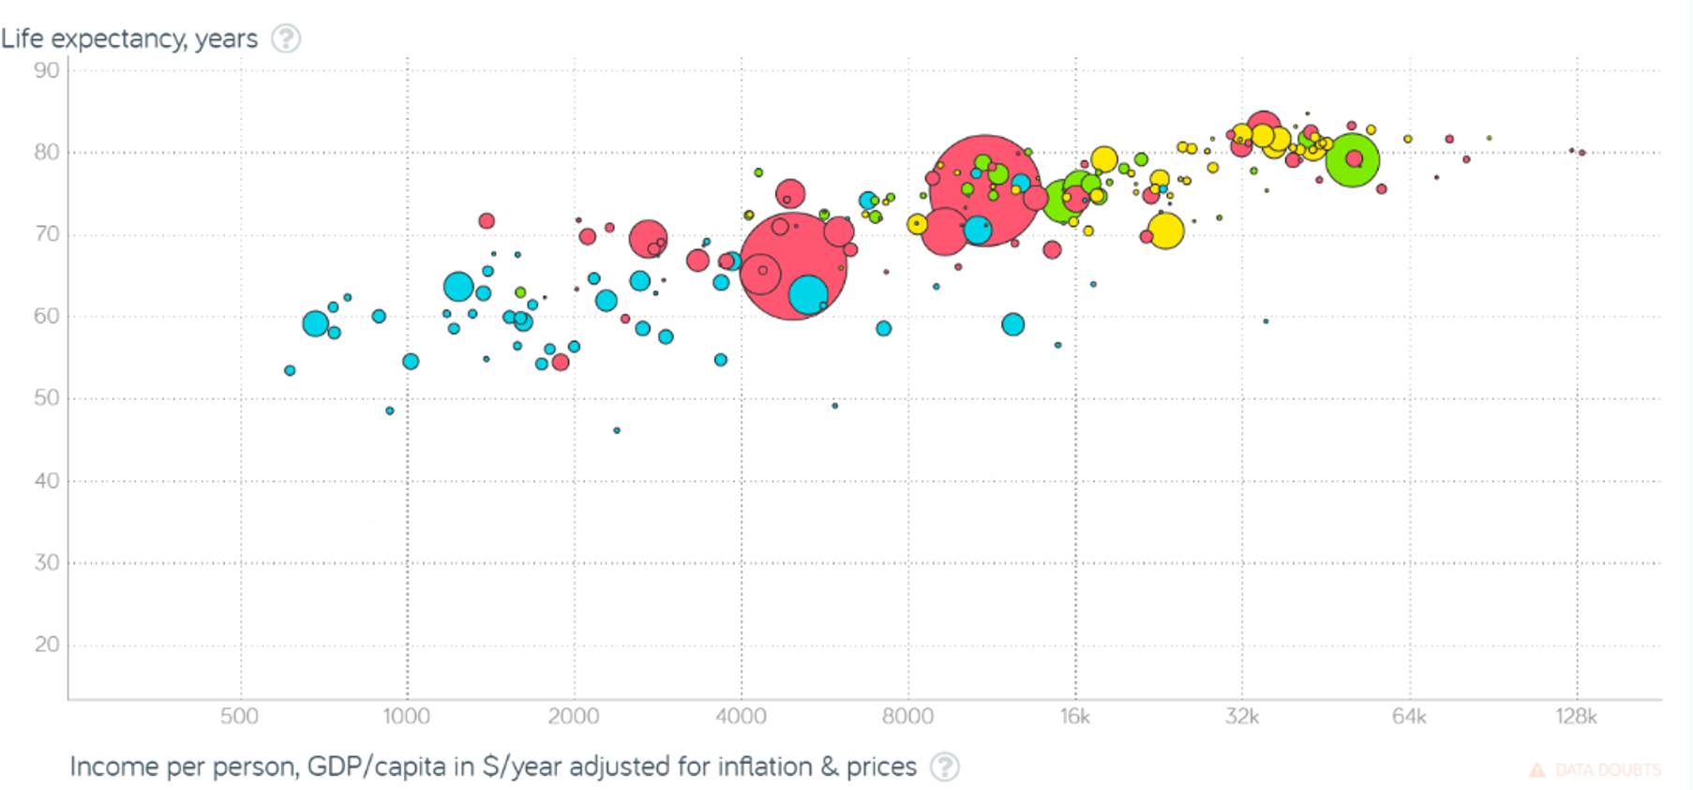
[Gapminder Foundation]
Non-Integrated Data

Slide 14
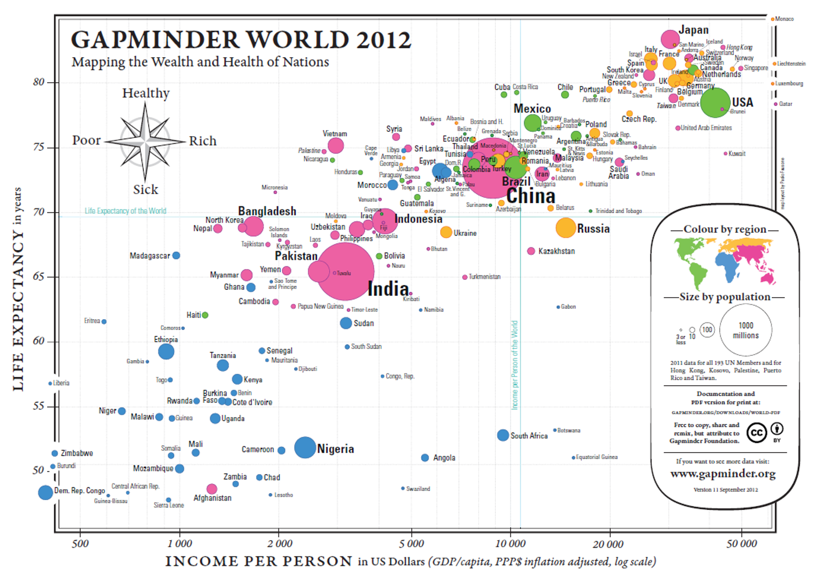
[Gapminder Foundation, https://www.ted.com/talks/hans_rosling_shows_the_best_stats_you_ve_ever_seen]

Slide 15
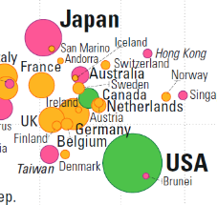
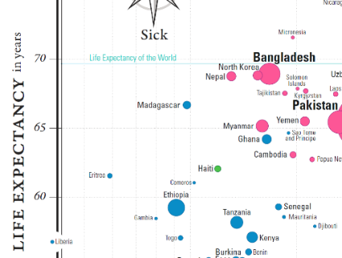
[Gapminder Foundation, https://www.ted.com/talks/hans_rosling_shows_the_best_stats_you_ve_ever_seen]
Meaningful Comparisons

Slide 16
[Gapminder Foundation, https://www.ted.com/talks/hans_rosling_shows_the_best_stats_you_ve_ever_seen]
Underlying Structure and Multivariate Links

Slide 17
[Gapminder Foundation, https://www.ted.com/talks/hans_rosling_shows_the_best_stats_you_ve_ever_seen]
Underlying Structure and Multivariate Links
Underlying Structure and Multivariate Links

Slide 18
[Gapminder Foundation, https://www.ted.com/talks/hans_rosling_shows_the_best_stats_you_ve_ever_seen]
Underlying Structure and Multivariate Links
Underlying Structure and Multivariate Links

Slide 19
[Gapminder Foundation, https://www.ted.com/talks/hans_rosling_shows_the_best_stats_you_ve_ever_seen]
Documentation

Slide 20
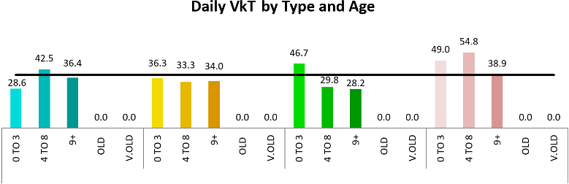
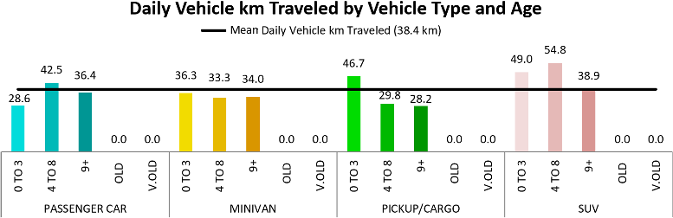
BASIC RULES
[http://flowingdata.com/tag/pitfalls]
1. Check the data outliers, spikes, anomalies
2. Explain encoding don't assume the reader knows what everything means
3. Label axes knowing the scale is important

Slide 21

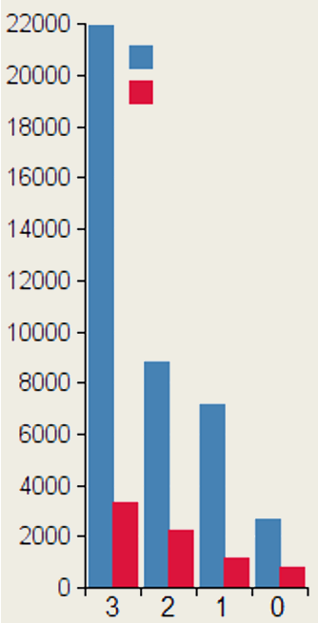
BASIC RULES
[http://flowingdata.com/tag/pitfalls]
Cancer cases
3.5 radius
Incidence
4. Include units eliminate the need for guesswork
5. Keep your geometry in check circles and 2D shape are sized by area, bar charts by length
6. Include your sources protect yourself, and let those who want to dig deeper do so
7. Consider your audience a poster can be wordy, a presentation should be minimalist
Mortality
3.5 area
Eggplant consumption, per week

Slide 22
A WORD ABOUT ACCESSIBILITY
[http://dataphys.org/list/]
Charts cannot usually be translated to Braille. Describing the features and emerging structures in a visualization is a possible solution… if they can be spotted.
Analysts must produce clear and meaningful visualizations, but they must also describe them and their features in a fashion that allows all to "see" the insights. This requires analysts to have “seen” all the insights, which is not always possible.
Conditions: colourblindness, low vision, motor impairment, cognitive disability, ADHD, etc.
Best Practices: high contrast text/elements, zoom/magnifications, keyboard navigation, assistive design, short summaries, undo/redo functionality, etc. [F. Elavsky]

Slide 23
A WORD ABOUT ACCESSIBILITY
Data Perception:
texture-based representations
text-to-speech
sound/music
odor-based or taste-based representations (?!?)
Sonifications:
TRAPPIST Sounds : TRAPPIST-1 Planetary System Translated Directly Into Music
Listening to data from the Large Hadron Collider, L. Asquith

Slide 24
Visualization Catalogue
DATA VISUALIZATION BASICS

Slide 25
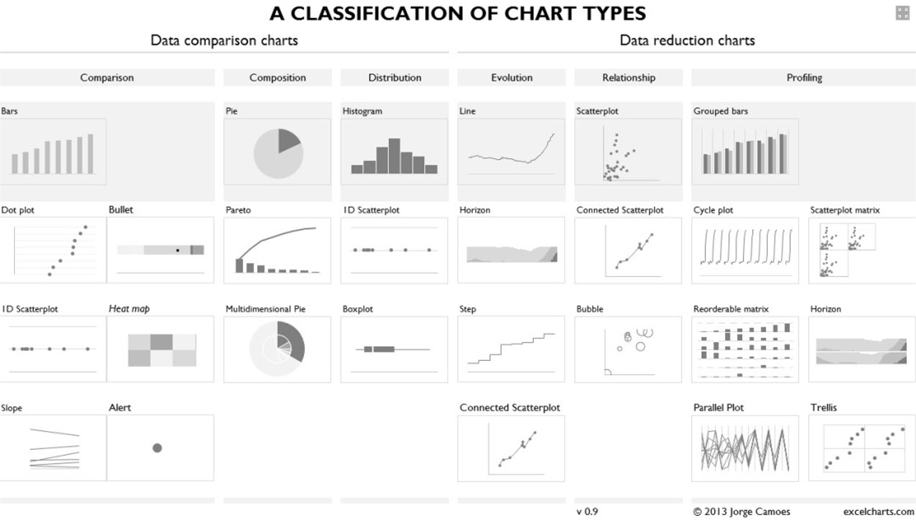

Slide 26
DATA DISPLAYS
With data displays, we try to highlight:
a relationship (show a connection or correlation between two or more variables);
a comparison (set some variables apart from others, and display how those two variables interact);
a composition (collect different types of information that make up a whole and display them together), and
a distribution (lay out a collection of related or unrelated information to see how it correlates, if at all, and to understand if there's any interaction between the variables).

Slide 27
SIMPLE TEXT AND TABLES
One or two numbers to focus on may help “set the scene” and draw focus to an area of the report.
Tables interact with our verbal system (we read them):
used to compare values
audiences will look for their rows
Table design needs to blend into background:
the data should stand out, not the borders
dense table: use alternating row colour
Leverage colour to convey magnitude:
use single colour saturation
use a legend to remove values
95% of the population
drinks tea today compared to
75% in 2007

Slide 28
TABLES AND TABLE HEATMAPS
Name | Last Year | This Year
Ron | 20 | 30
Fred | 30 | 40
George | 10 | 15
Name | Last Year | This Year
Ron | 20 | 30
Fred | 30 | 40
George | 10 | 15

Slide 29
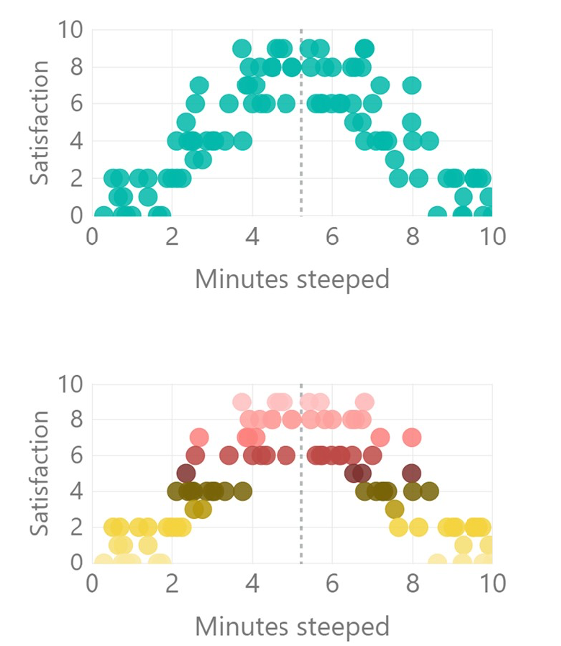
SCATTERPLOTS
How long should the perfect cup of tea be steeped?
Show relationship between 2 variables (scatterplot) or 3 variables (bubble plot):
use average lines (dotted lines) to provide context
far fewer options in Power BI than in R or Excel
consider using groupings to add clarity (e.g. colour gradients)

Slide 30
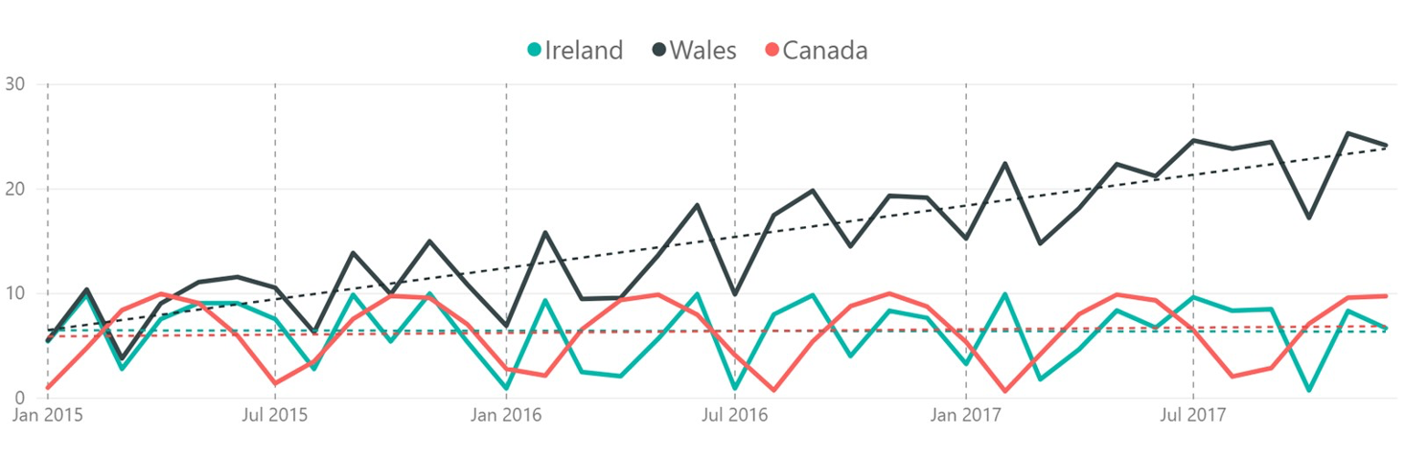
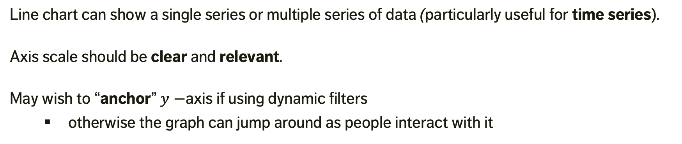
LINE CHARTS
Line chart can show a single series or multiple series of data (particularly useful for time series).
Axis scale should be clear and relevant.
May wish to “anchor” $y−$axis if using dynamic filters
otherwise the graph can jump around as people interact with it
Comparison of Countries – cups of tea drunk per week per person

Slide 31
BAR CHARTS
Versatile and useful.
ALWAYS (?) use a zero baseline.
Use graph axis OR data labels: axis for broad statements, data labels for details.
Horizontal charts are apparently easier to read (according to many studies).
Think about the ordering of categories.

Slide 32
CHART TYPES
Stacked Bar Charts
100% Bar Charts
Area Charts
Treemaps
Gauge Charts
Heatmaps and Choropleth Maps
Geographical Maps
Parallel Coordinates
Chernoff Faces
Word Clouds
Network Diagrams
Dendrograms and Trees
Sparklines
Interactive Charts
Small Multiples
etc.

Slide 33
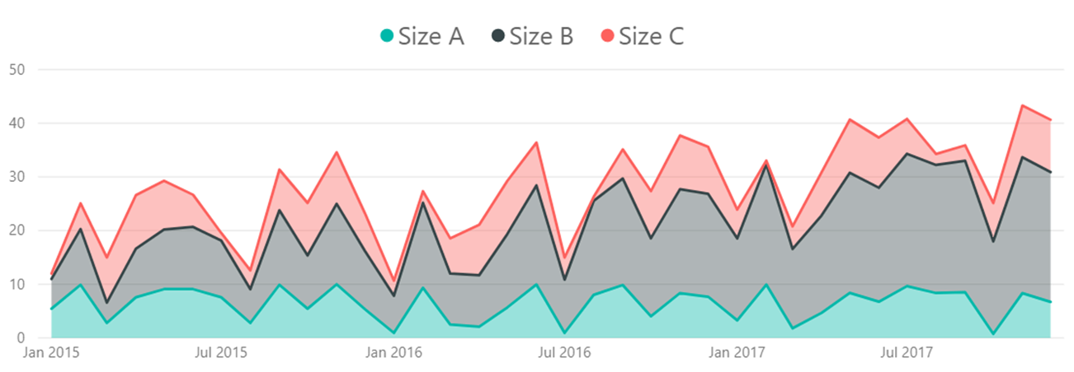
CHARTS TO AVOID
AVOID (?) anything with an arc (except gauge charts): pie, donut, etc: human brains have a hard time comparing arcs -- without labels, how different are Steve & Bob?
AVOID 3D charts: it is difficult to compare them visually (and they add too much clutter).
AVOID stacked area charts: way too confusing.

Slide 34
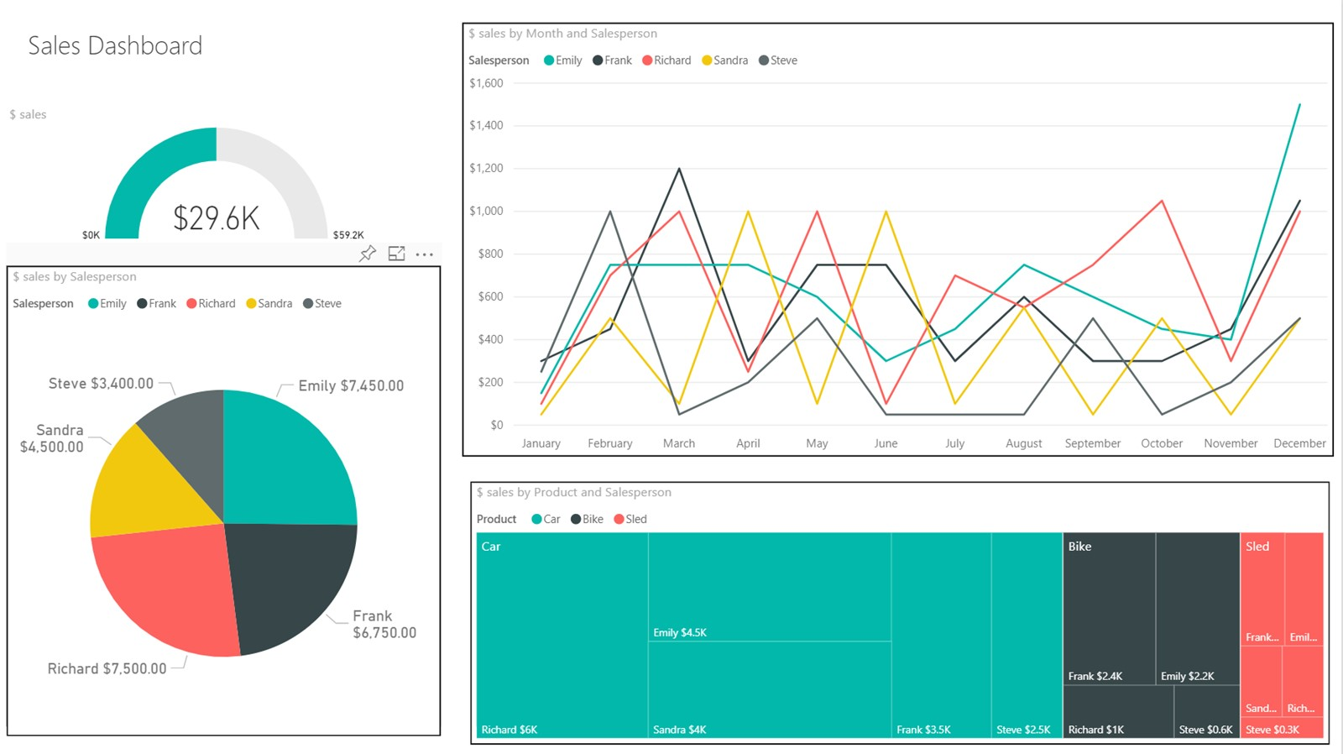

Slide 35
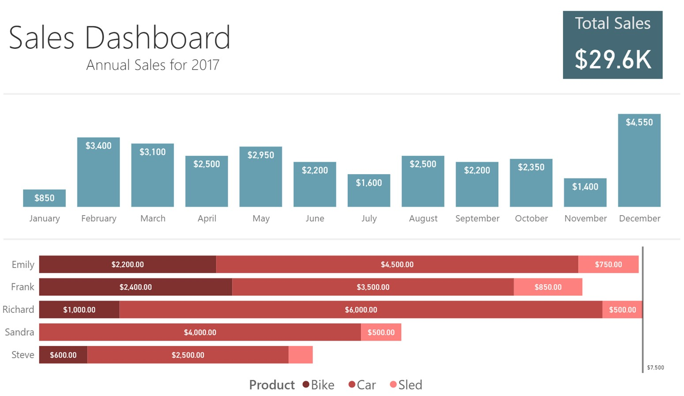

Slide 36
TAKE-AWAYS
Effective data visualizations provide insights and facilitate understanding.
The basic principles can guide your visualization design and consumption.
Be creative but keep your data and your representations honest.
Be mindful of attempts to distort trends and conclusions with flashy visuals.
Data and code should be made available along with the displays.

Slide 37
BASIC RULES OF DESIGN AND LAYOUT
DATA VISUALIZATION BASICS

Slide 38
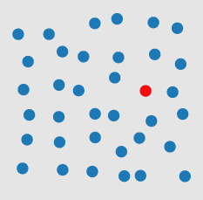
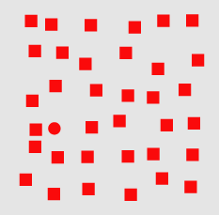
VISUAL PROCESSING
pre-attentive
Perception is fragmented – eyes are continuously scanning.
Visual thinking seeks patterns
Pre-attentive processes: fast, instinctive, efficient, multitasking gather information and build patterns:
features → patterns → objects
Attentive process: slow, deliberate, focused discover features in the patterns:
objects → patterns → features
Challenge: highlighting one aspect of a chart can make other aspects harder to see.
attentive
Notes:
Pre-attentive processes

Slide 39
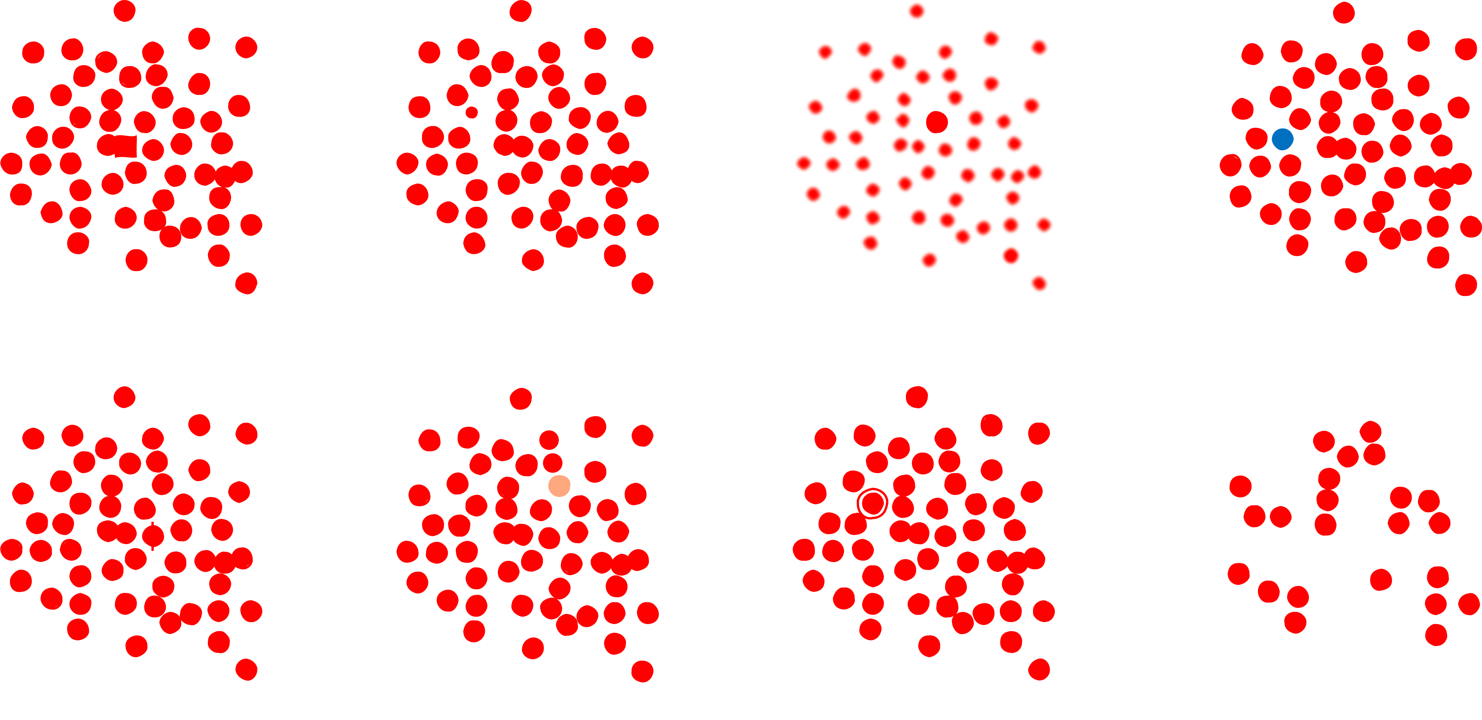
PRE-ATTENTIVE FEATURES
[P. Boily, S. Davies, J. Schellinck, The Practice of Data Visualization]
shape
size
sharpness
color/hue
markings
intensity/value
enclosure
numerosity

Slide 40
PRE-ATTENTIVE ATTRIBUTES
[P. Boily, S. Davies, J. Schellinck, The Practice of Data Visualization]
How many 6’s are
there on the next slide?

Slide 41
[P. Boily, S. Davies, J. Schellinck, The Practice of Data Visualization]
2869408609876
9348586748676
2967303986739
3967496749674

Slide 42
[P. Boily, S. Davies, J. Schellinck, The Practice of Data Visualization]
2869408609876
9348586748676
2967303986739
3967496749674

Slide 43
[P. Boily, S. Davies, J. Schellinck, The Practice of Data Visualization]
2869408609876
9348586748676
2967303986739
3967496749674

Slide 44
[P. Boily, S. Davies, J. Schellinck, The Practice of Data Visualization]
2869408609876
9348586748676
2967303986739
3967496749674

Slide 45
[P. Boily, S. Davies, J. Schellinck, The Practice of Data Visualization]
2869408609876
9348586748676
2967303986739
3967496749674

Slide 46
[P. Boily, S. Davies, J. Schellinck, The Practice of Data Visualization]
2869408609876
9348586748676
2967303986739
3967496749674

Slide 47
DECLUTTERING
CLUTTER IS THE ENEMY!
every element on a page adds cognitive load
identify anything that isn’t adding value and remove
think of cognitive load as mental effort required to process information (lower is better)
Tufte refers to the data to ink ratio – “the larger the share of a graphic’s ink devoted to data, the better”
in Resonate, Duarte refers to this as “maximizing the signal-to-noise ratio” where the signal is the information or the story we want to communicate.

Slide 48
DECLUTTERING
Use Gestalt Principles to organize/highlight data in a chart.
Align all the elements (graphs, text, lines, titles, etc.)
DON’T rely on eye, use position boxes and values
Charts:
remove border, gridlines, data markers
clean up axis labels
label data directly
Things
More things

Slide 49
DECLUTTERING
Use consistent font, font size, colour and alignment.
Don’t rotate text to anything other than 0 or 90 degrees.
Use white space:
margins should remain free of text and visuals
don’t stretch visuals to edge of page or too close to other visuals
think of white space as a border

Slide 50
CHART SIZES
Assuming that the chart has been decluttered:
things of equal importance size similarly;
other things scale to importance.
As one rarely puts more than 3-4 charts on a page, there are limited size options.
Perennial exception: geographical maps may require more space.

Slide 51

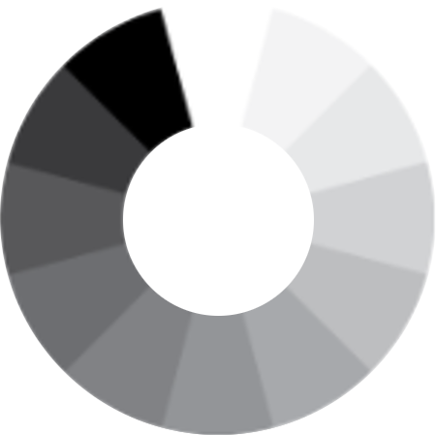
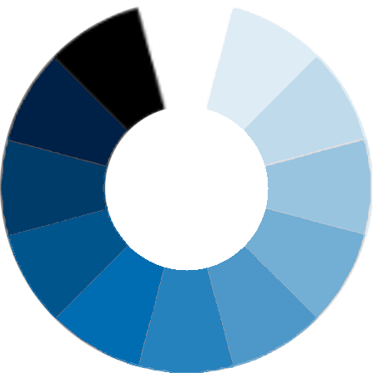
COLOUR SCHEMES
[http://www.deanenettles.com/webexamples/colorexamples]
Split-Left/Right Complementary
Analogous
Colour Diad
Colour Triad
Colour Tetrad
Achromatic
Monochromatic
Complementary
Split complementary

Slide 52
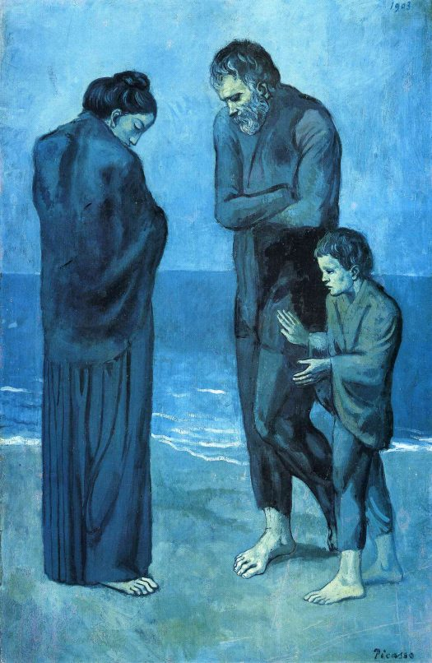

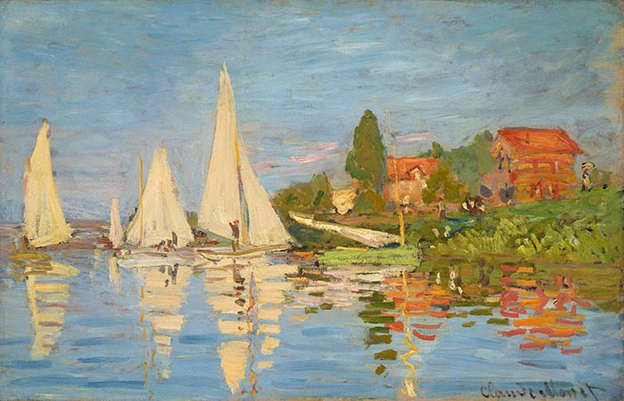






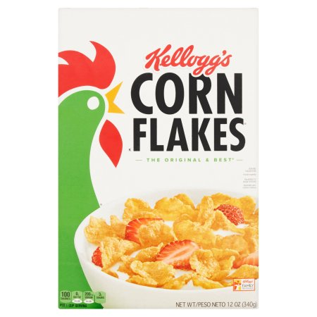


Can you identify the colour schemes underlying each of these images?

Slide 53
Split Complementary (Green, Orange & Blue)
Achromatic
Monochromatic (Blues)
Tetrad
Diad (Blue & Green)
Triad (Primary Colors)
Diad (Green & Orange)
Analogous (Green & Yellow)
Complementary
Can you identify the colour schemes underlying each of these images?
Diad (Red &Violet)

Slide 55
COLOUR SCHEMES
When it comes to colour, less is more: use it sparingly (graphic designers are taught to “get it right, in black and white”).
Based on the Gestalt Principles, monochrome schemes can be particularly effective.
When appropriate, pick scheme based on corporate identity (this maximizes buy in).
Create a template (and stick to it).
Upload images to see what charts look like in various flavours of colour-blindness:
https://www.color-blindness.com/coblis-color-blindness-simulator (there are other tools)

Slide 56
POSITION
How should the elements be placed in a chart or a dashboard?
In the West, most people start at the top left and zig- zag all the way to the bottom right.
Simple rule: don’t make people work too hard
main message: top left/top right
info in order of preference
people concentrate less as they scan so get less complex as you move to bottom corner
1
2
3
4

Slide 57
DASHBOARDS
DATA VISUALIZATION BASICS

Slide 58
DASHBOARDS
[Wexler, Shaffer, Cotgreave, The Big Book of Dashboards]
A dashboard is any visual display of data used to monitor conditions and/or facilitate understanding.
Examples:
interactive display that allows people to explore motor insurance claims by city, province, driver age, etc.
PDF showing key audit metrics that gets e-mailed to a Department’s DG on a weekly basis.
wall-mounted screen that shows call centre statistics in real-time.
mobile app that allow hospital administrators to review wait times on an hourly- and daily-basis for the current year and the previous year.

Slide 59
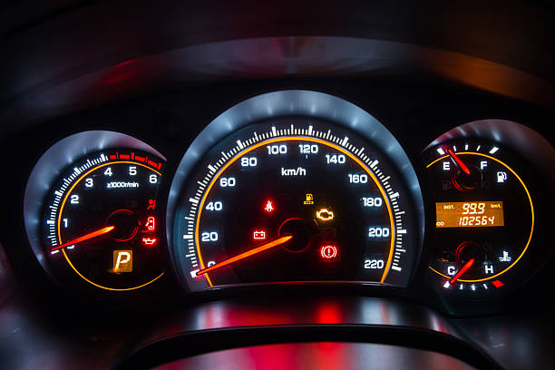
SOME QUESTIONS TO PONDER
In a car’s dashboard, a small number of key indicators (speed, gasoline level, lights, etc.) need to be understood at a glance. A dashboard design that does not take these two characteristics under consideration can have catastrophic consequences.
The following questions need to be answered prior to the dashboard being designed:
Who is the dashboard’s consumer?
What story does the dashboard tell?
What data (categories) will be used?
What will appear on the dashboard?
How can the dashboard help the consumer?

Slide 60
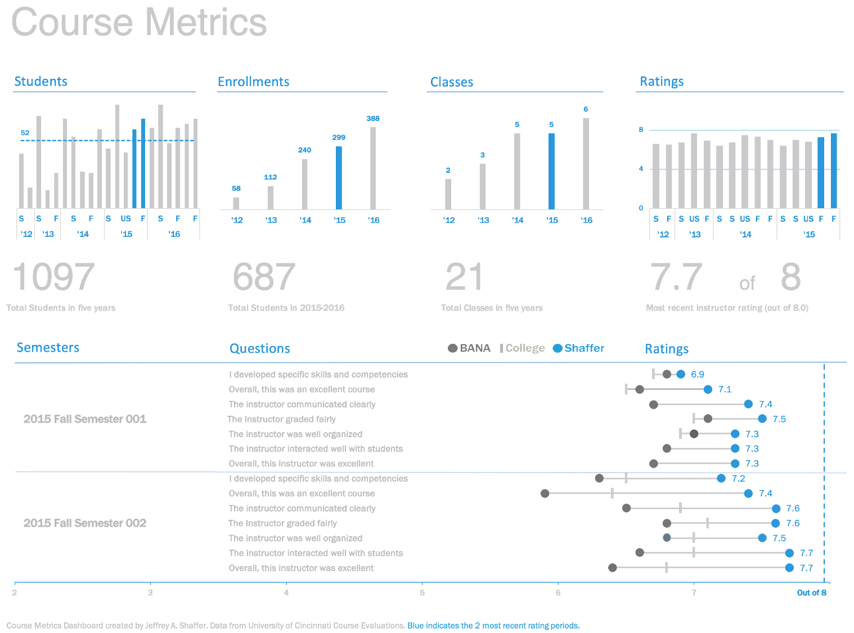
[https://bigbookofdashboards.com/dashboards.html]
Strengths:
Easy-to-see key metrics
Simple color scheme
Potential to be static or interactive
Both overview and details are clear
Notes:
https://bigbookofdashboards.com/dashboards.html

Slide 61
DASHBOARD EVALUATION
There are no perfect dashboards – no collection of charts will ever suit everyone who encounters it.
All dashboards should be truthful and functional, but dashboards that are also elegant (delightful, enjoyable) will take you further.
All dashboards are incomplete. Good dashboards will still lead to dead ends, but they should allow users to ask: “Why? What is the root cause of a problem?”
Tools: Excel, Power BI, Tableau, R + Shiny, Geckoboard, Matillion, etc.

Slide 62
EXERCISE
Consider the following dashboards.
Can you figure out, at a glance, who their audience is?
What are their strengths?
What are their limitations?
How would you improve them?

Slide 63
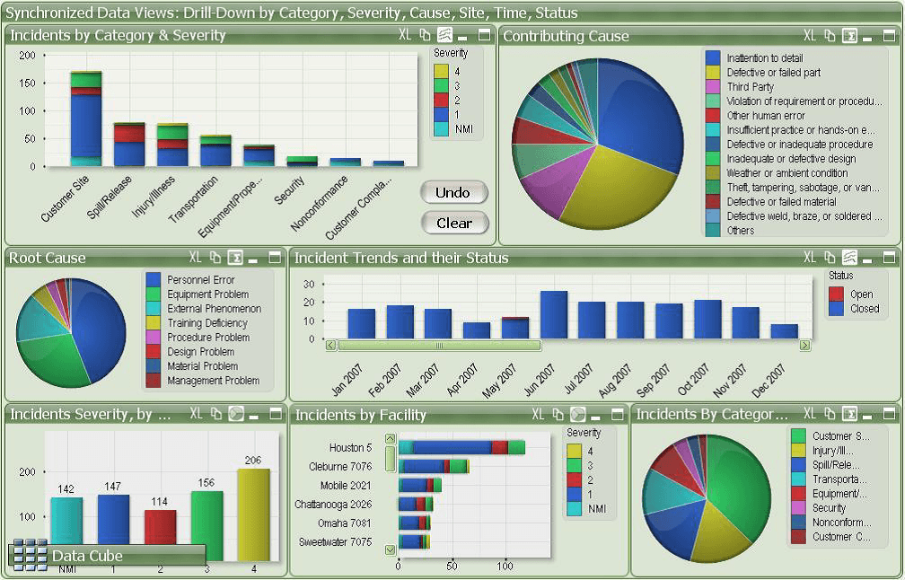
[https://www.matillion.com/wp-content/uploads/2014/11/qlikview-poor-use-of-dashboard-software.png]
Notes:
https://bigbookofdashboards.com/dashboards.html

Slide 64
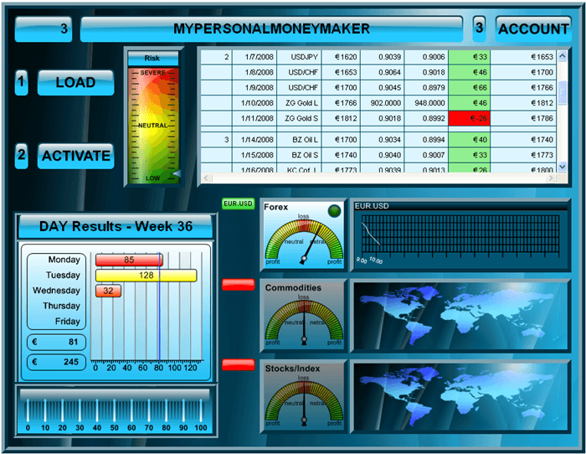
[https://www.geckoboard.com/assets/2-terrible-dashboard-example-min.png]
Notes:
https://bigbookofdashboards.com/dashboards.html

